Slide 1

CodeKataBattle Project RASD and DD
Ferlin Francesco – Giacomo Orsenigo – Federico Saccani

Slide 2
Requirements Analysis and Specification Document RASD
Notes:
Start person talking (Orsenigo)

Slide 3
Goals of the System (1/2)
G1: Educators can organize tournaments of programming exercises aimed at improving their students’ skills.
G2: Educators can organize battles in a tournament they have created.
G3: Educators can aid their colleagues in creating battles.
G4: Educator can decide how to score a battle they have created.
G5: Students can be notified about new tournaments.
G6: Students can subscribe to tournaments.
G7: Students can be notified about new battles in tournaments they are subscribed to.
G8: Students can form teams to take part in a battle.
G9: Teams of students can join a battle.
G10: Students and educators can monitor the progress of all students in battles and tournaments.
G11: Educators can manage students’ gamification badges.
G12: Students can receive badges depending on the rules they have fulfilled.
G13: Students and educators can see badges collected by a student.
Notes:
Skip immediatly to the next slide to see the subdivision
0,05s

Slide 4
Goals of the System (2/2)
G1: Educators can organize tournaments of programming exercises aimed at improving their students’ skills.
G2: Educators can organize battles in a tournament they have created.
G3: Educators can aid their colleagues in creating battles.
G4: Educator can decide how to score a battle they have created.
G5: Students can be notified about new tournaments.
G6: Students can subscribe to tournaments.
G7: Students can be notified about new battles in tournaments they are subscribed to.
G8: Students can form teams to take part in a battle.
G9: Teams of students can join a battle.
G10: Students and educators can monitor the progress of all students in battles and tournaments.
G11: Educators can manage students’ gamification badges.
G12: Students can receive badges depending on the rules they have fulfilled.
G13: Students and educators can see badges collected by a student.
Educators managing
Tournaments + Battles
Students actions
Tournaments + Battles
+ Teams
Monitoring progress
Scores + Badges
Notes:
0,05s-0,27s

Slide 5
World and Machine Phenomena
A user wants to log in to the platform
A user logs in
An educator wants to create a tournament
An educator creates a tournament
An educator grants permissions for a tournament
to another educator
The system pulls the latest sources,
analyses them, and runs the tests
A student wants to take part in a tournament
A student subscribes to a tournament
The system notifies students
about a new tournament
A student wants to see the ranking in a battle
An educator creates a battle as part of a tournament he has permissions for
The system notifies students
subscribed to a tournament about a
new battle in said tournament
The system calculates the
battle score of the team.
A student wants to invite
other students in a tournament
A student invites another student to take part in a battle with him
The system sends the link to a GitHub repository
containing the code for a battle to all students who
are members of subscribed teams
An educator wants to see the ranking in a battle
A student accepts the invitation of another student to take part in a
battle with him
A student joins a battle on their own
World
Shared
Machine
The registration deadline of a battle expires
A student pushes a new commit in their
repository main branch
The system notifies students
taking part in a battle that the
final battle rank is available
The platform updates the
personal tournament score of
each student
A student forks the GitHub repository
A student or an educator visualize the current rank of a battle
An educator manually evaluates the submission of a
team for a battle he has created
A student sets up the automated workflow
The system notifies students taking part in a
tournament that the final tournament
rank is available
An educator closes the consolidation stage
A student writes code
An educator closes a tournament
Any subscribed user visualizes the
list of current tournaments
The submission deadline expires
and the consolidation stage starts
Any subscribed user visualizes
the ranking of a tournament
An educator defines a badge
A student achieves a badge
Any subscribed user visualizes the
badges achieved by a student
Any subscribed user visualizes the badges achieved by a student
Notes:
Dire il perché abbiamo messo i fenomeni nel mondo, shared o machine senza nominarli tutti
Say the most important phenomena very quickly After this slide, change person speaking (Saccani now talking)
0,27s-1,07s

Slide 6
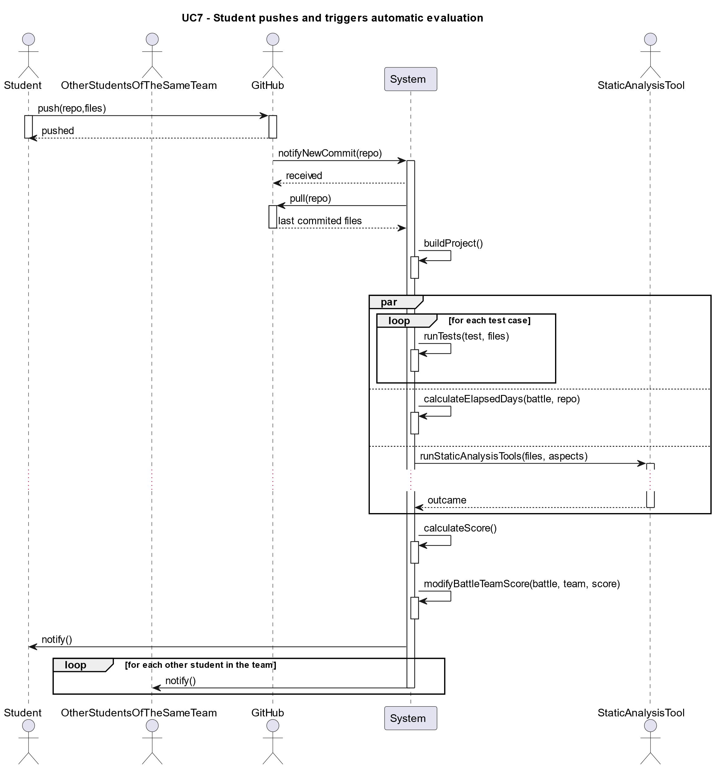
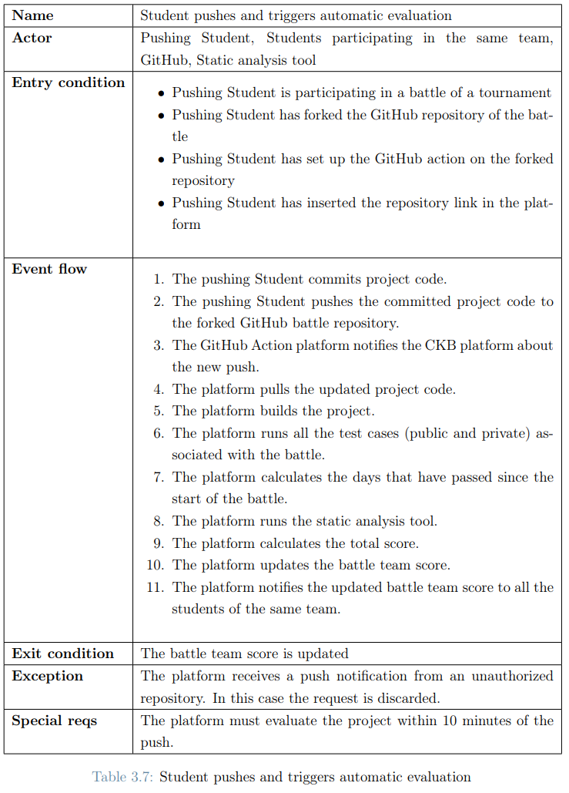
A Meaningful Use Case
UC7: Student pushes and triggers automatic evaluation
Notes:
A meaningful use case is the UC7: «Student pushes and triggers automatic evaluation» We decided to present this use case because it includes some of the most important actors like «the system», «the static analysis tool», «the github platform» and «the students in the team».
The event flow starts with the student committing and pushing the new source code to the github repo.
Then, the GitHub Action platform notifies the system about the the push.
The system can now pull the new updated source code and start analyzing it.
The first thing the system does is building the project and after that it can perform in parallel 3 different operations in order to calculate the score.\
After all the three different operations has been completed, the system can calculate the score and modify the battle team score, notifing all students partecipating in the team.
1,07s-1,57s

Slide 7
Some of the most important Requirements (1/2)
The total number of requirements we identified is 21 (from R1 to R21). Some of the most important ones are the following:
R2: The system shall allow the educator to create a tournament
Also with R2.1, R2.2, R2.3 and R2.4 (allow managing the tournament)
R3: The system shall allow students to subscribe to a tournament
R4: The system shall allow the educator to create a battle within the context of a specific tournament.
Also with R4.1, R4.2, R4.3, R4.4, R4.5, R4.6, R4.7, R4.8, R4.9 and R.10 (allow managing the battle)
R5: The system shall allow students to join a battle, respecting the minimum
and maximum number of students per group.
Also with R5.1 and R5.2 (allow students to send and receive invitations)
R8: The system shall expose an API that can by called by the GitHub Action platform
R9: On each push, the system shall calculate and update the battle score of the team Also with R9.1, R9.2, R9.3 and R9.4 (properties in order to calculate the score)
R20: The system shall allow the educator who create a tournament, to create badges within
the context of the tournament.
Also with R20.1, R20.2, R20.3 and R20.4 (allow managing the badge)
Notes:
Now let’s talk about the requirements
Trought all the requirements those are the most important ones due to the fact that they rappresent the basic functionality of the system.
As we already highlighted in the previous slides we have:
the creation and partecipation in a tournament and in a battle,
the ability to see the result
the feature to create and manage the badges.
After this slide change person speaking (Ferlin now talking)
1,57s-2,15s

Slide 8
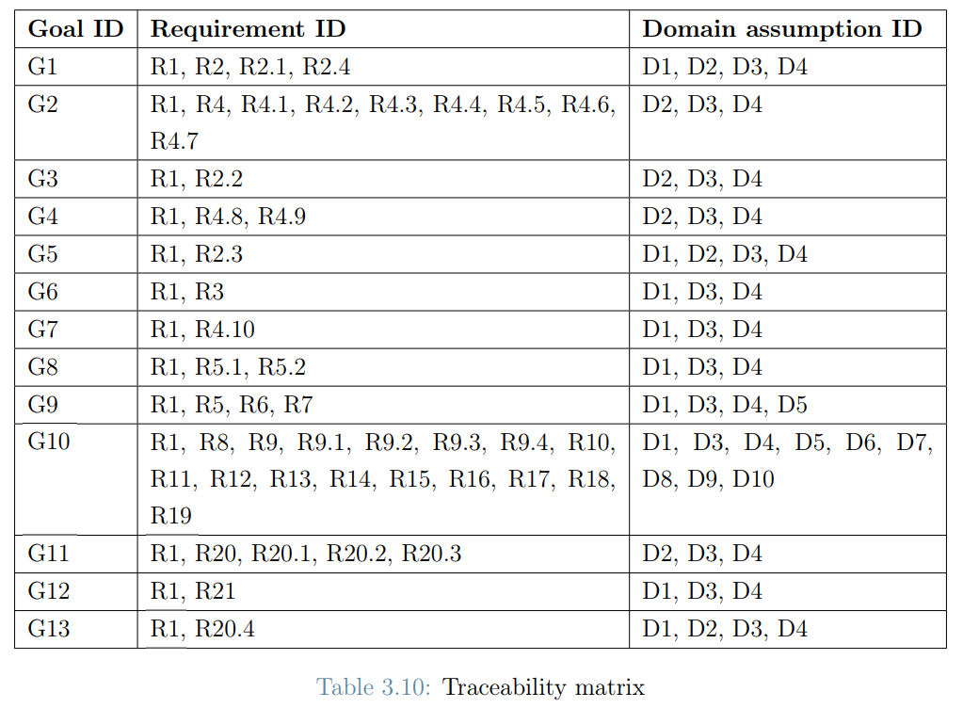
Some of the most important Requirements (2/2)
Traceability matrix:
R1
Allow log in with SSO
Notes:
First animation: red circles wrt previus important requirements Second animation: obvious R1 requirments to allow students to log in
After this slide change person speaking (Ferlin now talking)

Slide 9
Assumptions
D1: Students are enrolled in the school.
D2: Educators teach in the school.
D3: The school has an existing authentication system that can be used by the CKB platform.
D4: Students and educators have an account on the existing authentication system.
D5: Students correctly fork the GitHub repository of the code kata battle.
D6: Students correctly set up an automated workflow through GitHub Actions.
D7: The grade assigned manually by the teachers reflects the work done.
D8: The GitHub Action platform is working properly.
D9: Test cases and build automation scripts uploaded by educators are correct.
D10: The static analysis tool is working.
Accedemic Environment
Login based on University SSO (Single Sign On)
Correct behavior
By Students and Educators
Reliable External Dependecies
Notes:
We suppose that there is already existing school enviroment and so we defined the SSO …
2,15s-3,00s

Slide 10
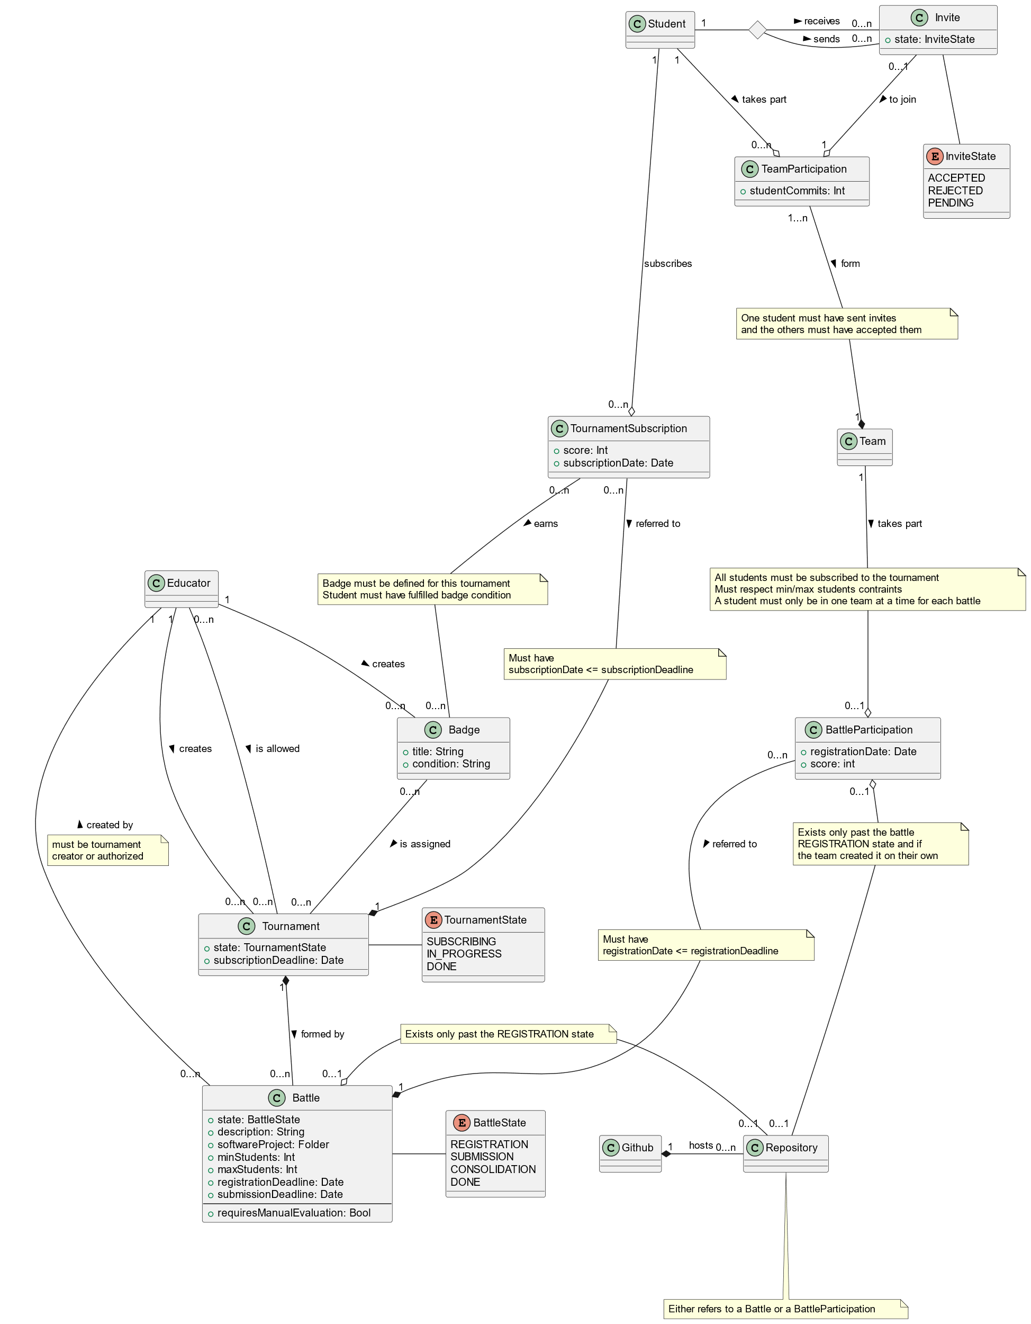
Alloy Model (1/3)
We translated the following Class Diagram into Alloy
Notes:
Now we can also show the Class Diagram and say that we translated all the elements in the Alloy Code
Both ways / both directions
3,00s-3,07s

Slide 11
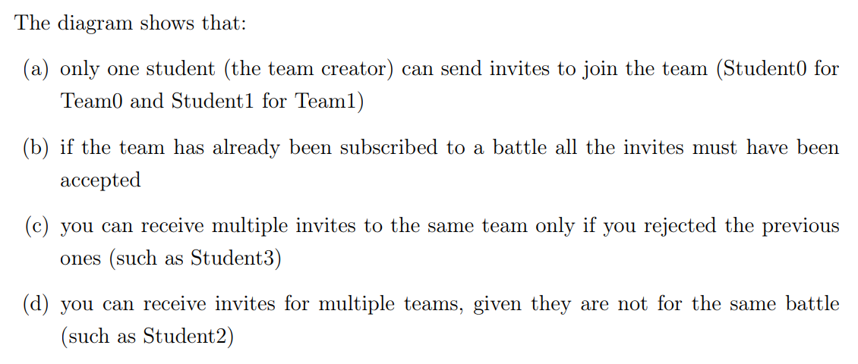
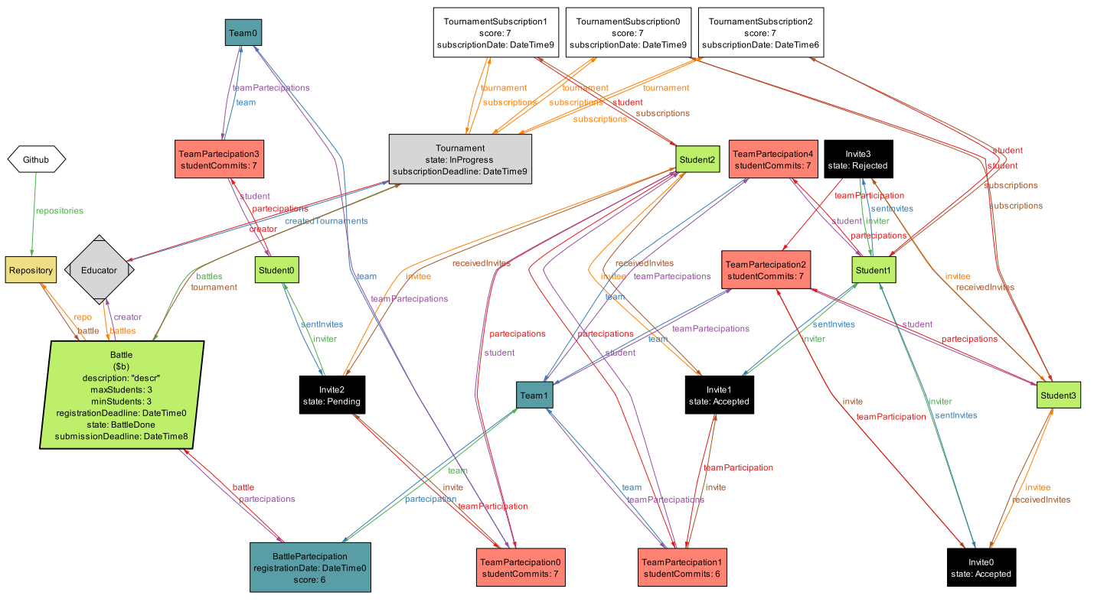
Alloy Model (2/3)
Notes:
This show some important properties like the invitation part (discussed more in detail with code in the next slide)
Both ways / both directions
3,07s-4,02s

Slide 12
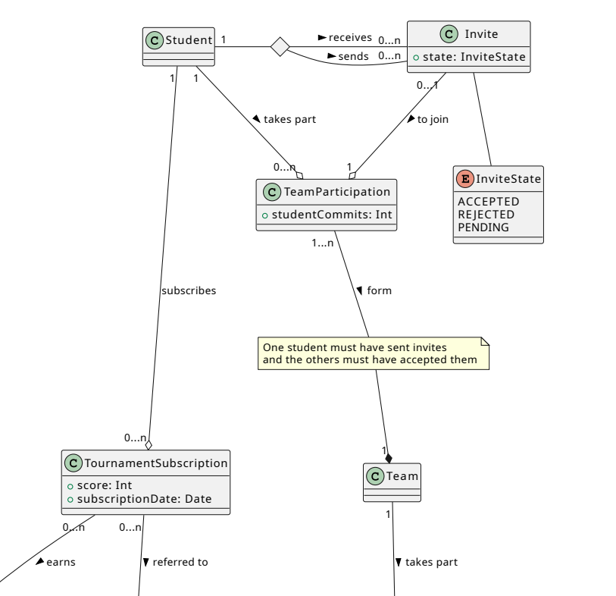
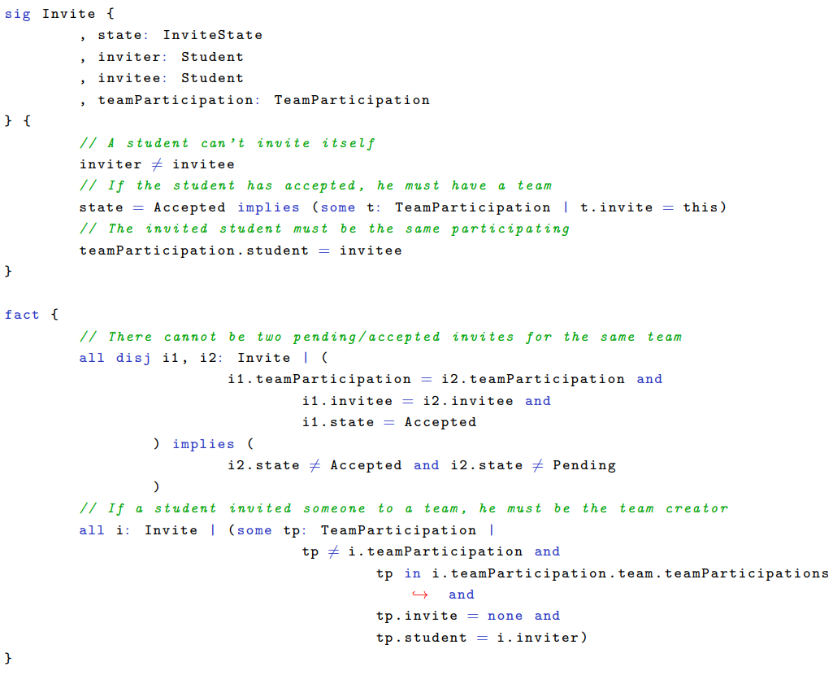
Alloy Model (3/3)
Zoom in the Class Diagram ‘Invite’ Section
Some extract of the Alloy Code regarding the ‘Invite’ property
Notes:
After this slide RASD part completed -> We will start talking about DD Change person speaking (Orsenigo Now Speaking)
4,02s-4,15s

Slide 13
Design Document DD

Slide 14
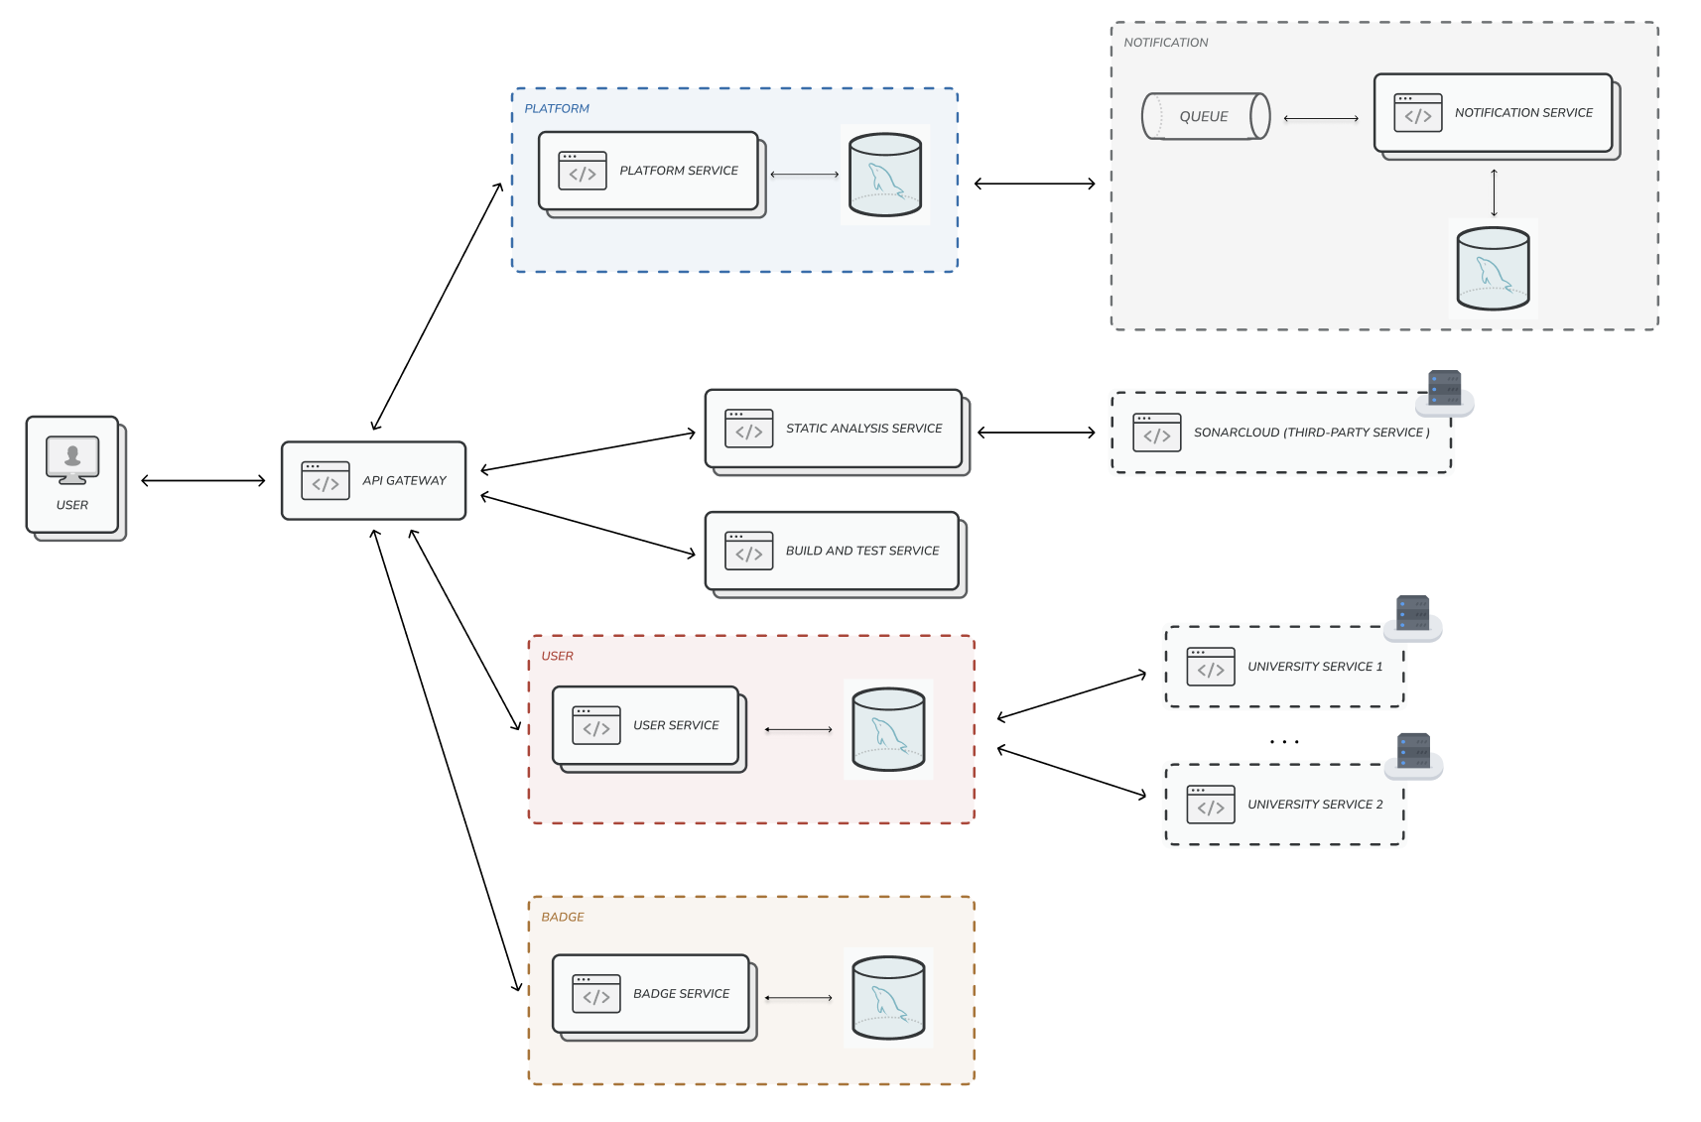
Component View (1/3)
Microservices Architecture
Low coupling
High cohesion
Flexibility and scalability: services can be duplicated since they don’t have to interact with shared databases that could become bottlenecks.
Notes:
Low coupling: each microservice is independent of the others
High cohesion: the tasks performed by each microservice are related
4,15s-4,55s

Slide 15
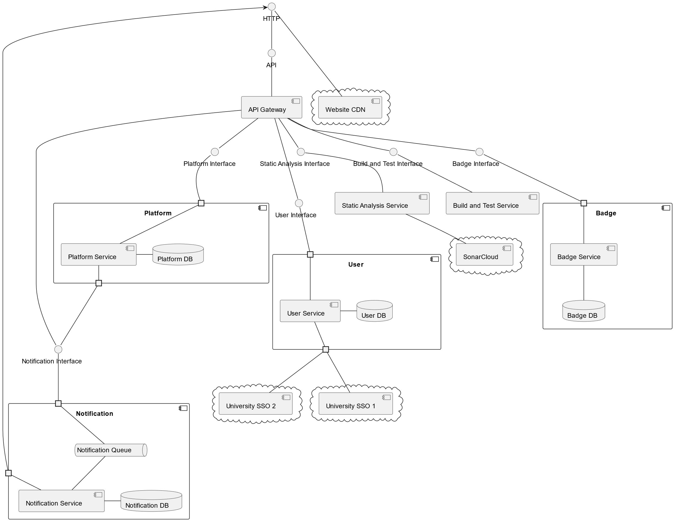
Component View (2/3)
Components
User Service
Platform Service
Badge Service
Build and Test Service
Static Analysis Service
Notification Service
Website CDN
API Gateway
Notes:
4,55s-5,00s

Slide 16
Component View (3/3)
Users interact with the system with SPA (single page app – Fat client)
SPA served by CDN (content delivery network)
Asynchronous Communication by using queue (notification, sonarcloud, build and test service)
Notes:
Explain the interaction of the components
The user gets static pages from the CDN which performs js calls to the api gateway in order to do its actions. The Api gateway communicates with all the necessary services internally. Microservices communicate among themselves trought the api gateway or by using queue implementing asyc comm such as in the notification microservices
5,00s-5,35s

Slide 17


Important Component and Interfaces (1/5)
We will consider only some of the most important interaction and architectural styles that we decided to implement in the system
API Gateway
Implemented by Spring Cloud Gateway build on top of Reactor project
allow to
and scale
handle High Traffic
the API Gateway horizontally when necessary
(if so, a load balancer, the Amazon ELB will equally distribute requests among the various instances. )
The API Gateway performs load balancing in case other microservices are replicated
Notes:
The Api Gateway is a staless component implemented using the reactive programming paradigm.
This allows to have an high level of scalability (its stateless) and to handle high amount of traffic (its reactive). This is the point where we can introduce a Load balancer which can distribute workloads across replicated Api Gateway istances. (la comunicazione parte sempre dall’api gateway quindi le risposte dei microservizi vanno verso l’istanza di api gateway da cui hanno ricevuto richiesta)
5,35s-6,05s

Slide 18
Important Component and Interfaces (2/5)
API Gateway
Relevant Interfaces:
– login(username: String, password: String): String? logs the user in through the sso service and, if successful, returns the authToken
– getListOfTournaments(authToken: String): List given a valid educator auth token, returns the list of tournaments which he has created or he has permissions to add battles to
– createBadge(authToken: String, badgeInfo: NewBadge): ID create a new badge with the given info and return its id
– createNewBattle(authToken: String, tournementId: ID, battleInfo: Battle): ID create a new battle with the given info and return its id
– addStudentNotificationEndpoints(authToken: String, endpoint: String): void add the URL of the notification endpoints of a student
….
Notes:
These are some of the interfaces of the api gateway.
We can note that we have an explicit authToken because the api gateway is in charge of validating requests, while the other services can expect already correct information about the identity of the user.
(Start speaking Saccani)
6,05s-6,35s

Slide 19

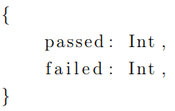
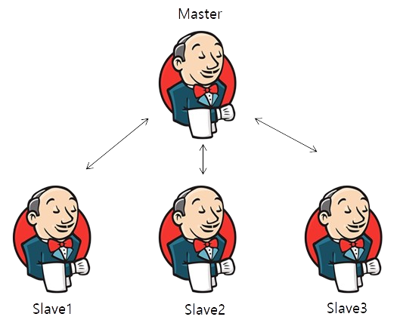
Important Component and Interfaces (3/5)
Build and Test Service
Relevant Interfaces:
Based on the Jenkins system
– buildAndTest(repo: Slug): TestReport build the given repository, run its tests and produce a report
Why?
It is the most CPU intensive service
and should adopt a distributed builds architecture
How?
Single Jenkins controller that schedules builds to dedicated build nodes (agents). Build agents can be dynamically deployed to a new Amazon EC2 instance
Notes:
Regarding the Build and Test Service we decided to adopt and already existing system called Jenkins. That’s because Jenkins already supports (with plugins) most of the programming languages that might get used in battles.
Additionally it already implements an internal queue (allowing async interaction) and
can schedule builds to dedicated nodes (called agents) which can be used to scale up the system on demand.
6,35s-7,25s

Slide 20

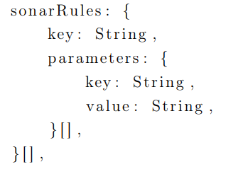
Important Component and Interfaces (4/5)
Static Analysis Service
Relevant Interfaces:
Based on the SonarCloud
– analyse(repo: Slug): SatReport run static analysis on the given repository and produce a report
How?
Inside each battle it’s specified the sonarRules field to be applied by SonarCloud when scanning
Notes:
Considering now the static analysis service
This is also a CPU intensive task and thus we decided to implement this feature with an already existing external service called sonarCloud.
It would have been not trivial reimplement all the static analysis tool for each programming languages that could have been used in battles. Each battle contains a sonarRules field that sonarCloud must consider in order to analyse the source code correctly.
------- (sonarQube è in locale ma costa di piú e inoltre solo la versione datacenter è scalabile (gli altri no cluster di worker),
sonarCloud costa 100k righe di codice 11 eu/mese, 250k 80eu/mese, .. Fino a 20mln righe al mese 5’250 eu/mese,
Public projects (open source) analysis is always free)
-------
7,25s-8,00s

Slide 21

Important Component and Interfaces (5/5)
Notification Service
Relevant Interfaces:
Asynchronous communication based on RabbitMQ
–addStudentNotificationEndpoints( studentId: ID, endpoint: String): void add the URL of the notification endpoints of a student
How?
Queue used by the Platform Service to push messages asynchronously The service will periodically pop messages from the queue with the Spring AMQP project and send them
Notes:
For the notification service we decided to implement it asynchrously using a pub-sub style pattern with RabbitMQ.
How we do it? The Platform Service uses the queue to push messages asynchronously The service will periodically pop messages from the queue with the Spring AMQP project (library to interact with the queue) and send them. (Chrome –(endpoint)-> Api gateway –(idStudent, endpoint)-> Notification ) (Platform –(idStudent)-> Notification -> send to endpoint) (Ferlo now speaking)
8,00s-8,30s

Slide 22


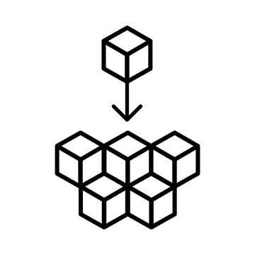


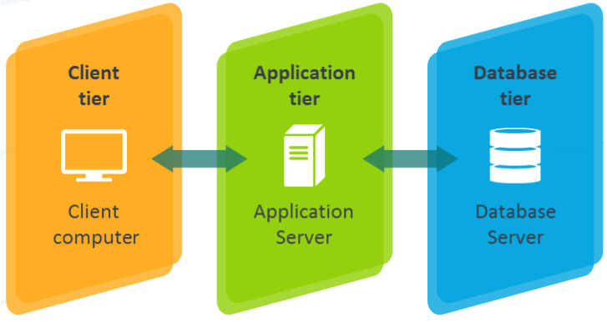

Selected architectural styles and patterns
Microservices Architecture
Fat Client
REST API
API Gateway
Remote Procedure Call
Pub-Sub/
Message
queuing
Tiered
Architecture
Stateless
Components
Notes:
8,30s-9,30s

Slide 23
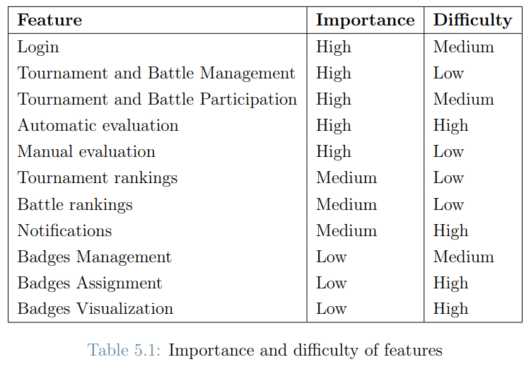
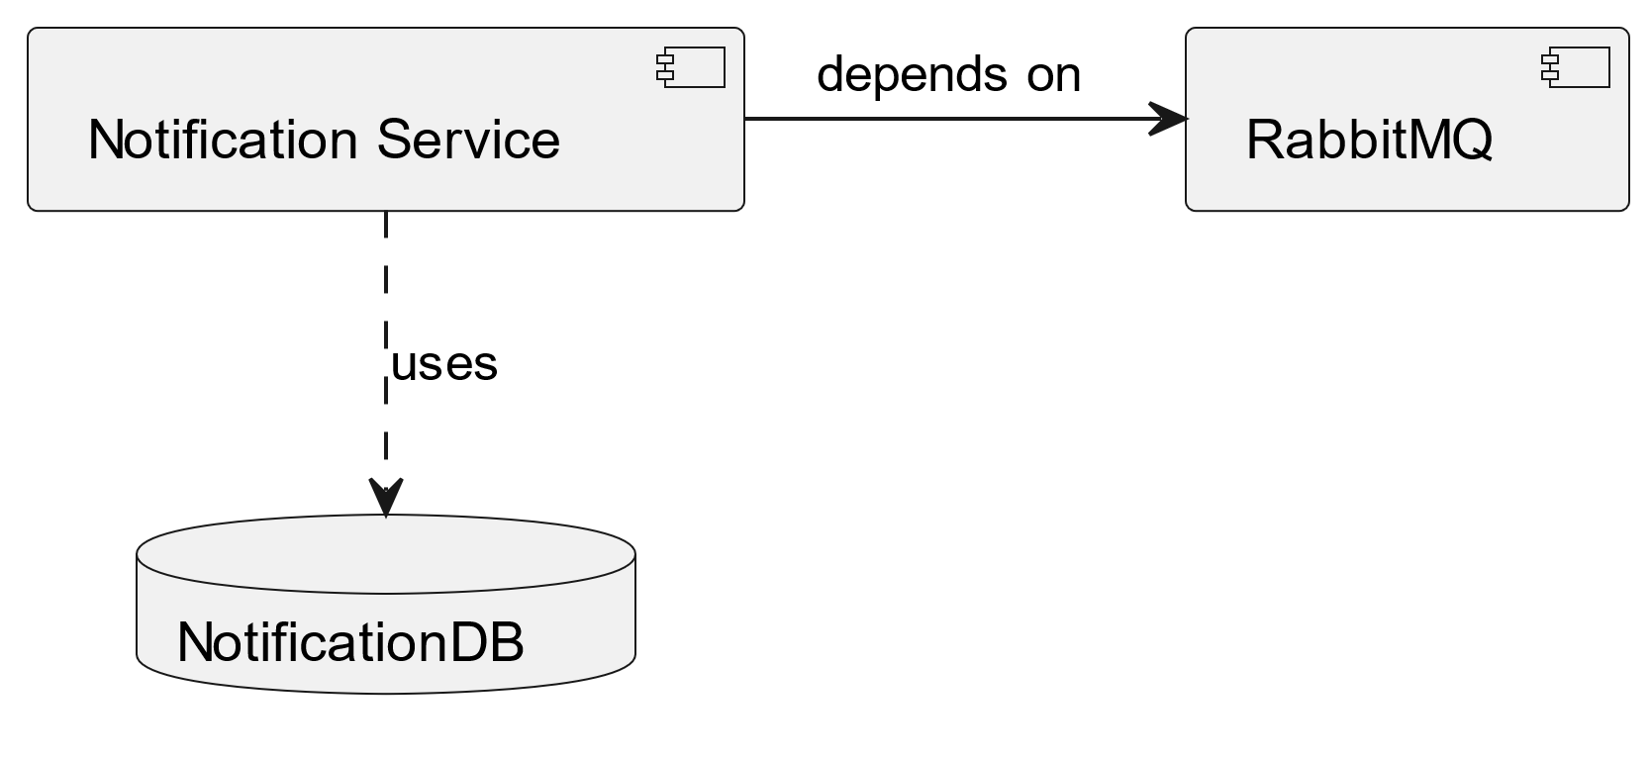
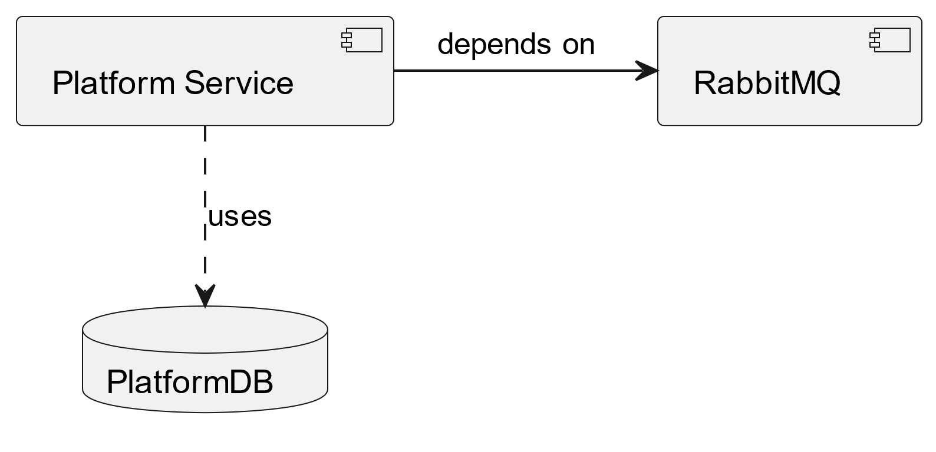
Components integration (1/3)
The chosen architecture guarantees high decoupling between components, so that most of them can be developed and unit tested completely independently
The order in which components are implemented and tested follows the importance and difficulty of features
Steps:
1. Notification Subsystem
2. Platform and Notification subsystem
Notes:
Avoid mocks and prefers derivers to stubs by adopting bottom-up approach.
9,30s-9,45s

Slide 24
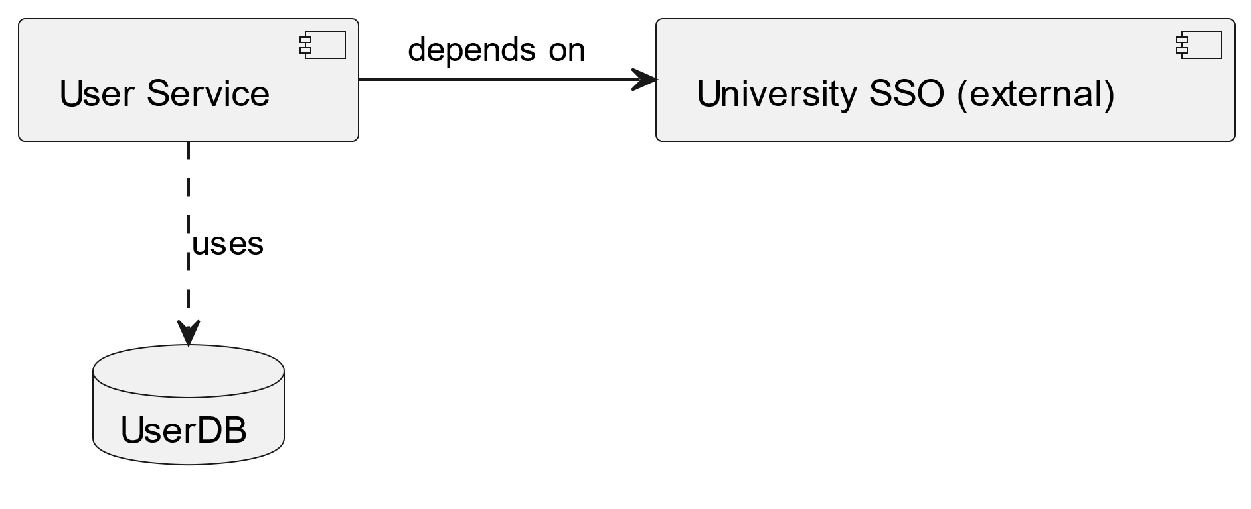
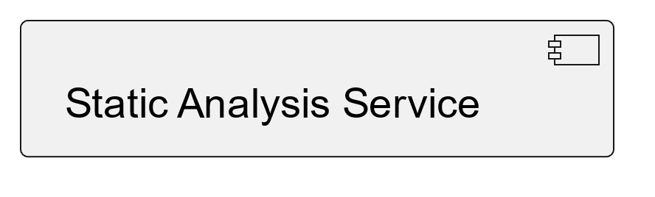
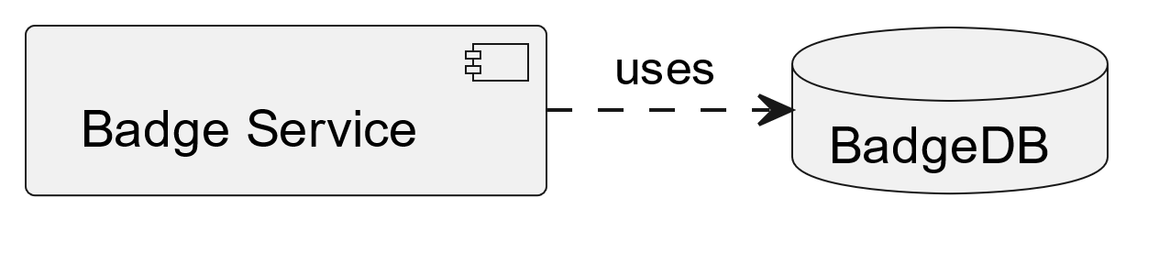
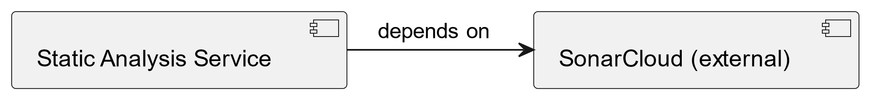
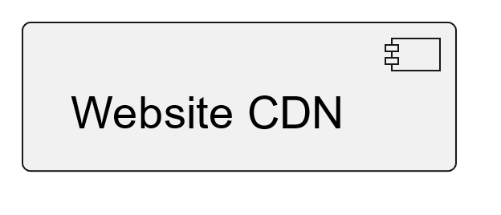
Components integration (2/3)
3. User subsystem,
the Build and Test subsystem,
the Static Analysis subsystem,
and then the Badge subsystem
In parallel
//
//
//
4. Website CDN
Notes:
9,45s-10,05s

Slide 25
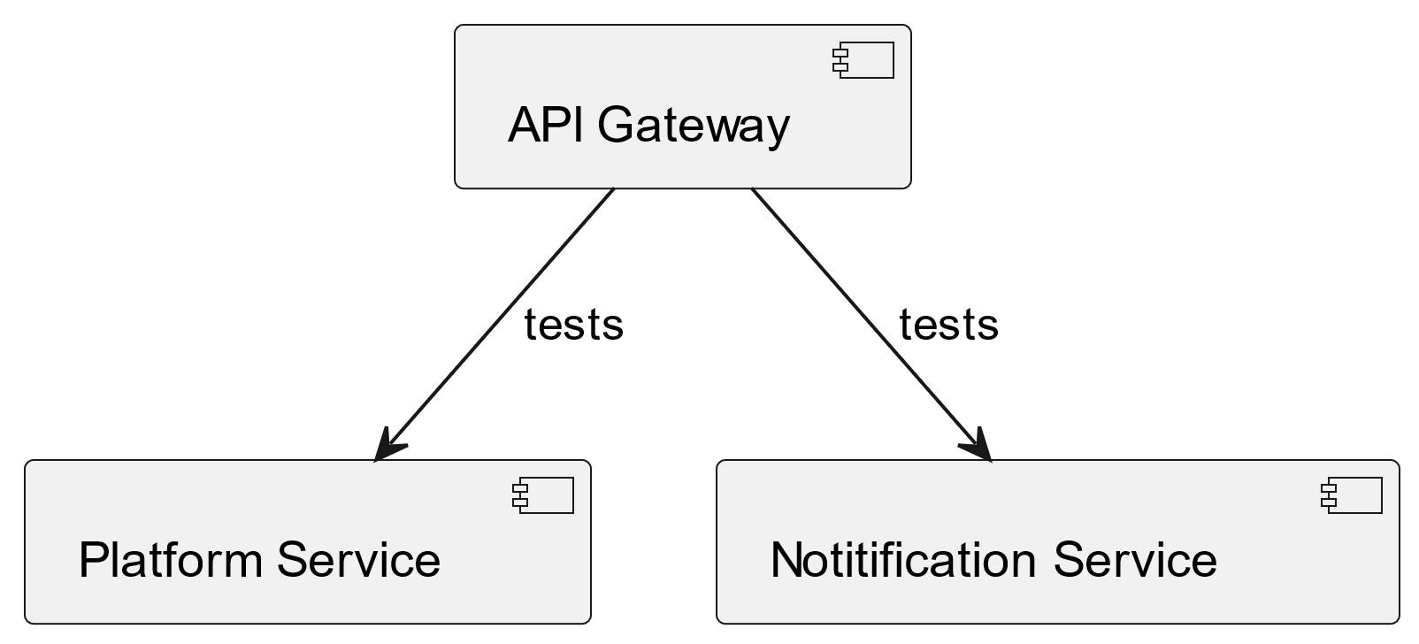
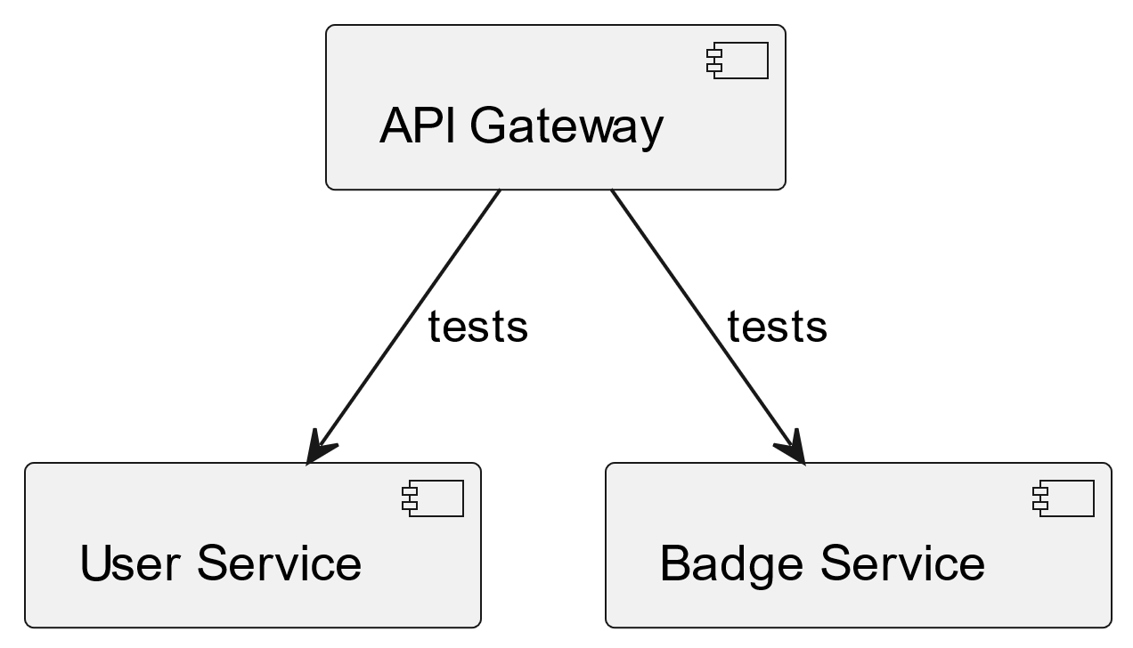
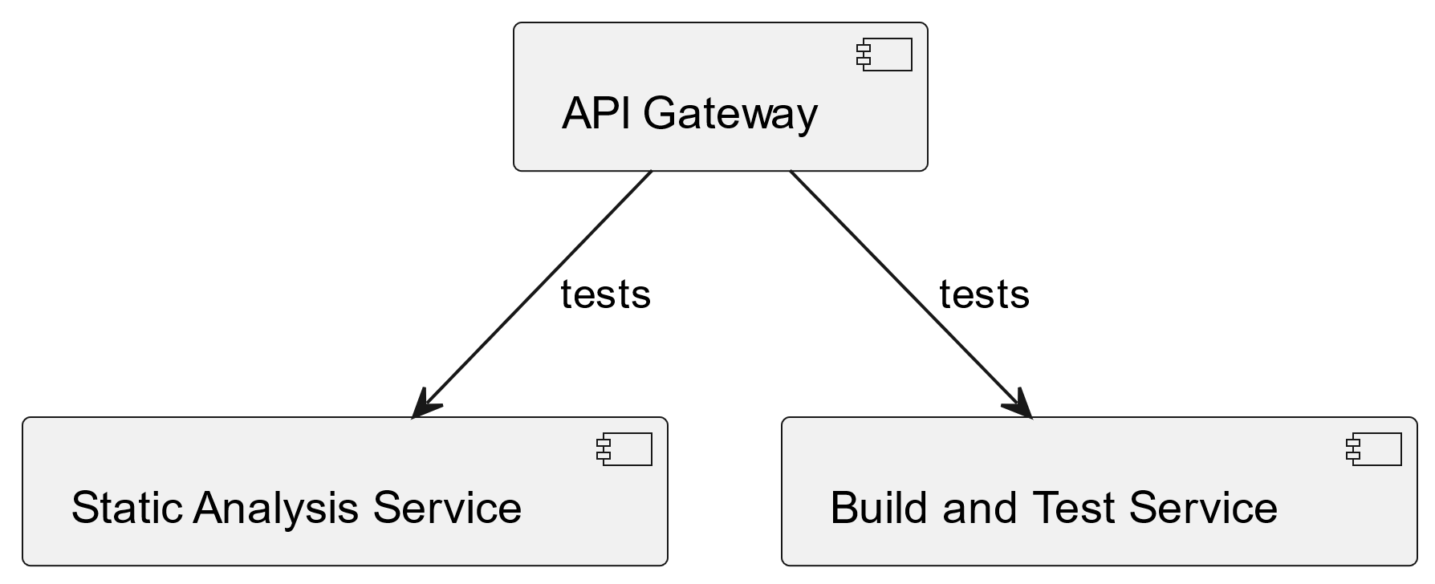
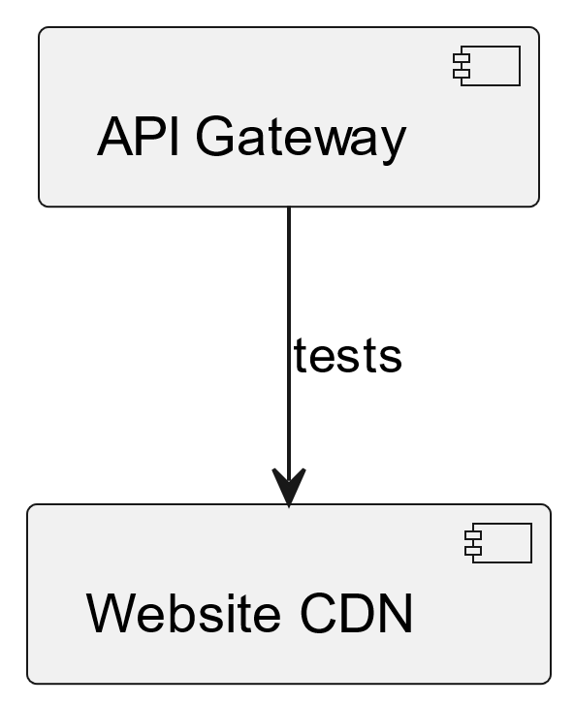
Components integration (3/3)
5. API Gateway with all the previous subsystems
6. Website CDN and API Gateway
Notes:
10,05s-10,20s

